Slide 1


Python Data Science For Fun And Profit
Presented By
Eng. Ahmed Genedy
Gene IT Solutions
www.gene-eg.com

Slide 2



About Gene IT Solutions
AKA BigProf Software, bigprof.com
Established since 2003.
Developers of AppGini, one of the fastest and easiest tools for small businesses to create powerful web-based multi-user business applications, without writing any code.
Over 100,000 users world-wide.
We believe in open source, and in users having full control of their business tools.
We recently launched a plugins market place to expand our tool set .. And you’re welcome to join!

Slide 3

What is data science?
Data Science is the study of data. It is about extracting, analyzing, visualizing, managing and storing data to create insights. These insights help governments, organizations, companies, researchers, .. etc. to make powerful data-driven decisions. Data Science involves the usage of both unstructured and structured data.

Slide 4

A crash course in Python

Slide 5
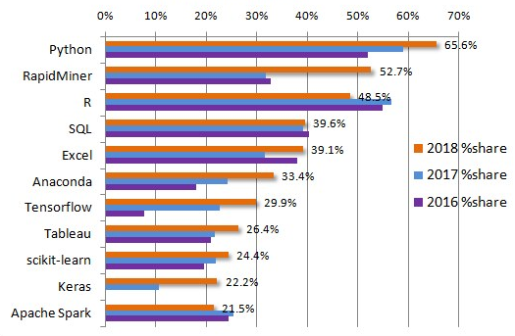
Why Python for data science?
Growing popularity.
Powerful data science libraries and tools.
Very easy to learn and use.
Great community.

Slide 6
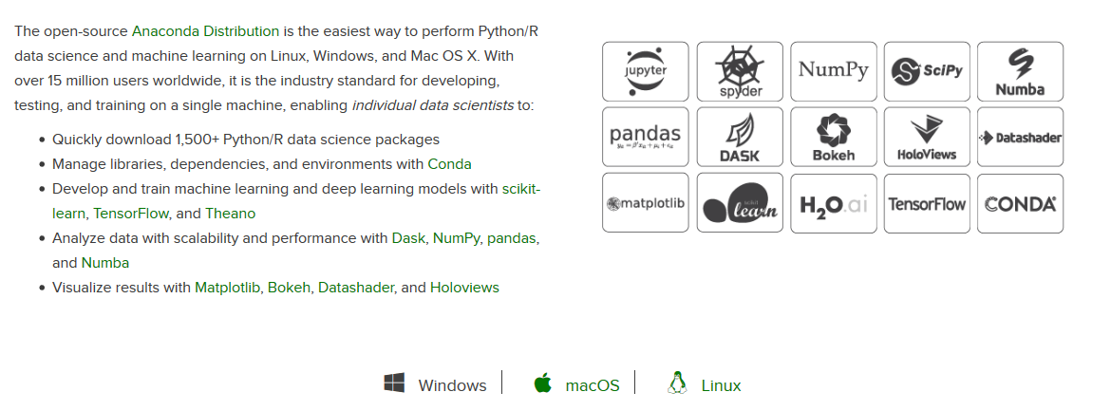
Tools needed: Anaconda, anaconda.com

Slide 7
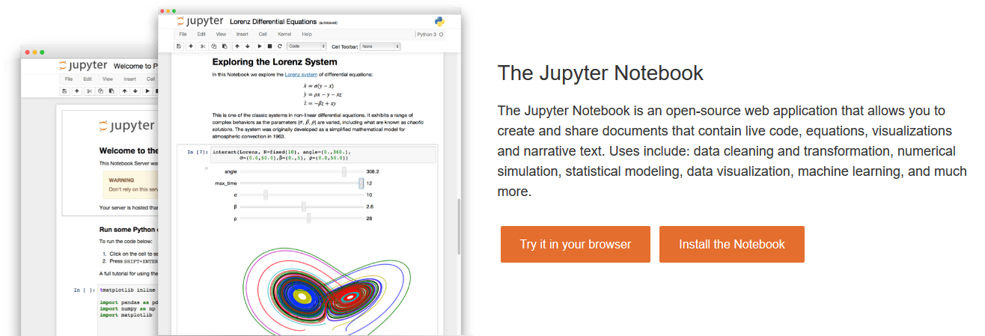

Slide 8
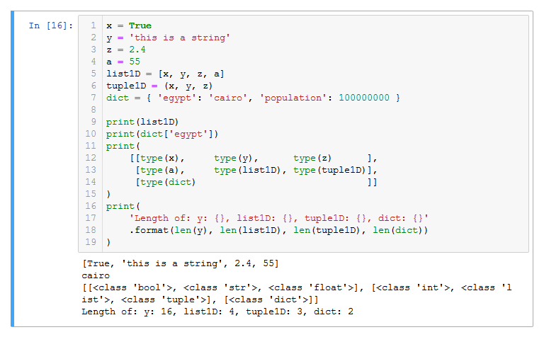
Core data types of Python

Slide 9
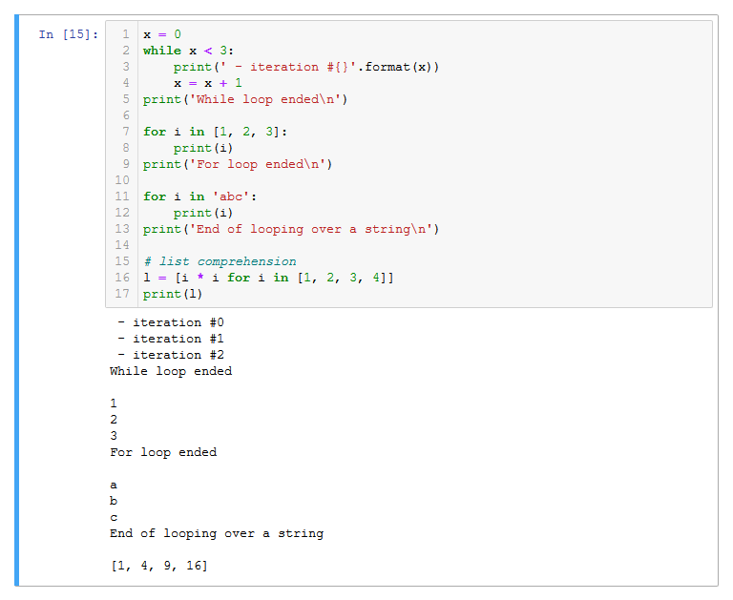
Loops

Slide 10
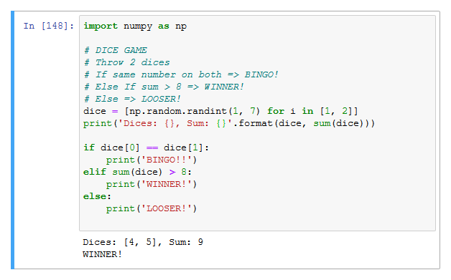
If/else checks

Slide 11
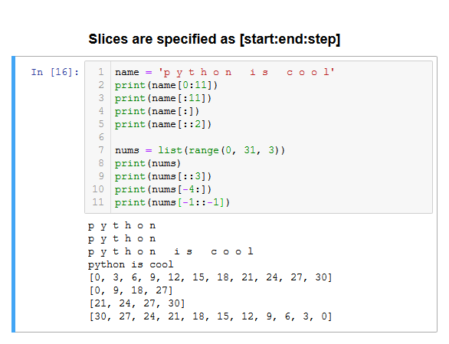
Slicing

Slide 12
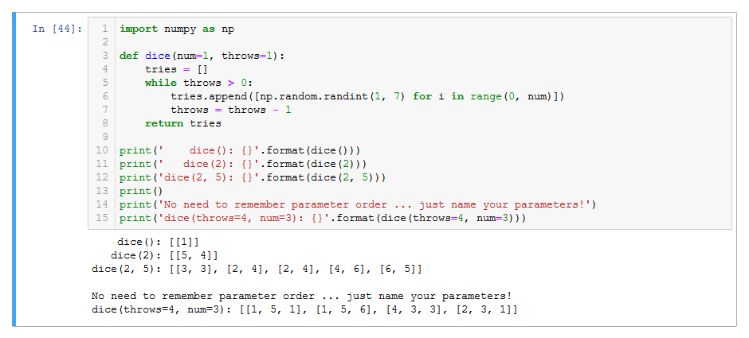
Defining functions

Slide 13
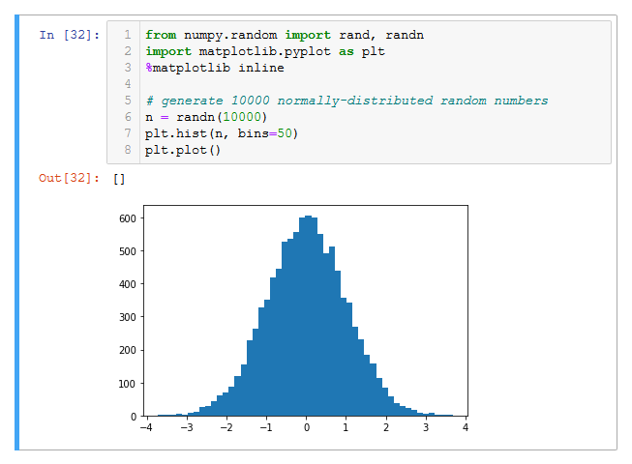
Hello matplotlib!

Slide 14
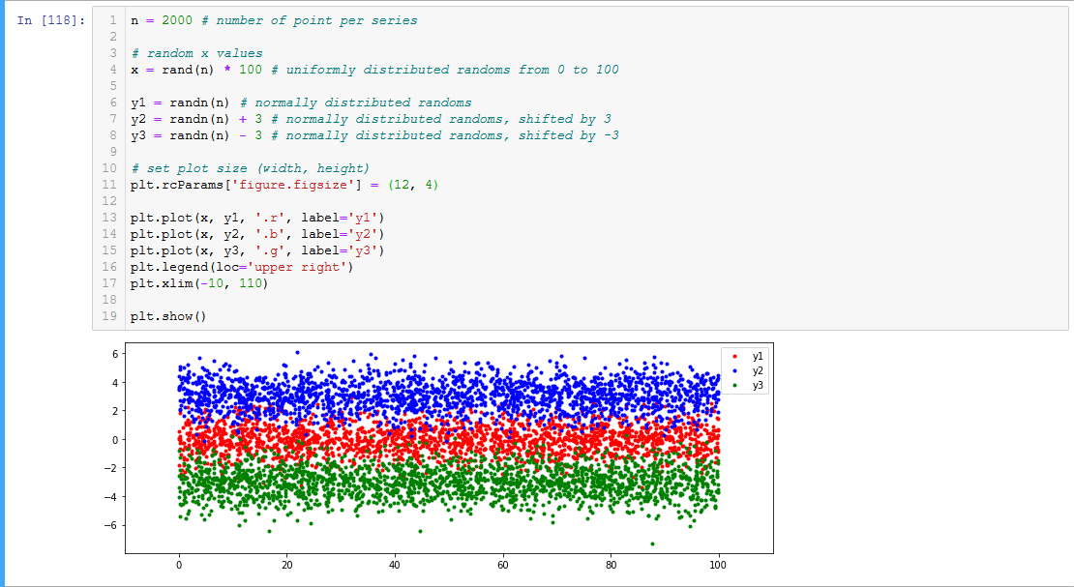
Another matplotlib example

Slide 15

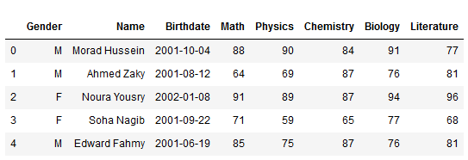
Pandas and data frames
Columns
Index
Data

Slide 16
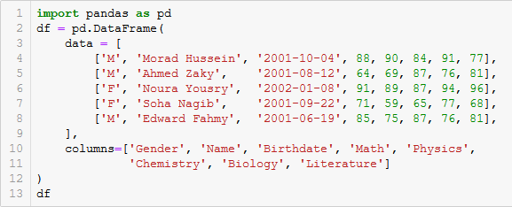
Manually defining a data frame

Slide 17
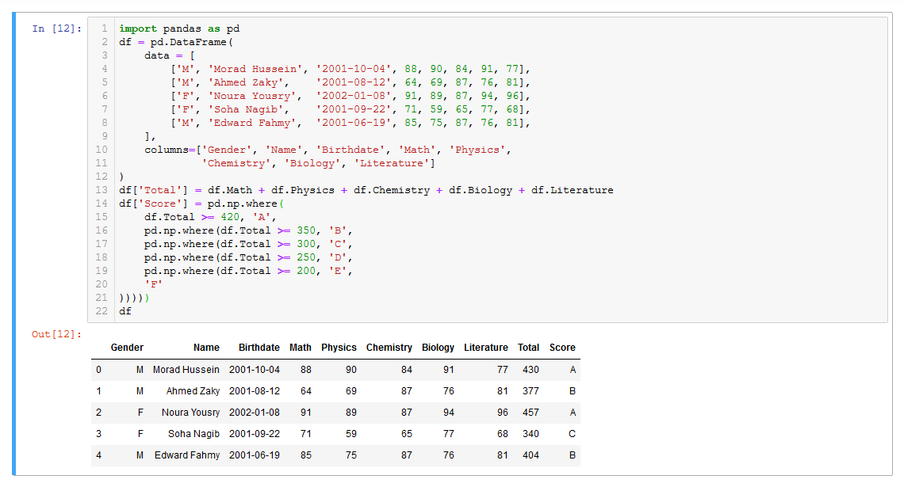
Data frame calculations

Slide 18

Let’s play with some real-world data!
Uber raw pickup data for NYC, April 2014, https://www.kaggle.com/fivethirtyeight/uber-pickups-in-new-york-city
(find the file ‘uber-raw-data-apr14.csv’)

Slide 19
Exploring the data set
Load
Load data: data = pd.read_csv(‘path/to/file’)
Preview
Take a look on how the data looks like: data.head() data.tail()
Inspect
See how are column data types recognized (and memory usage): data.info() data.describe()
Clean up
Clean up data. For example, to convert date/time string to a datetime object, adjust loading to: data = pd.read_csv(‘path/to/file’, parse_dates=[0])
Tip
Tip: you’ll know dates are parsed if you see them in the format: Y-m-d or Y-m-d H:i:s

Slide 20
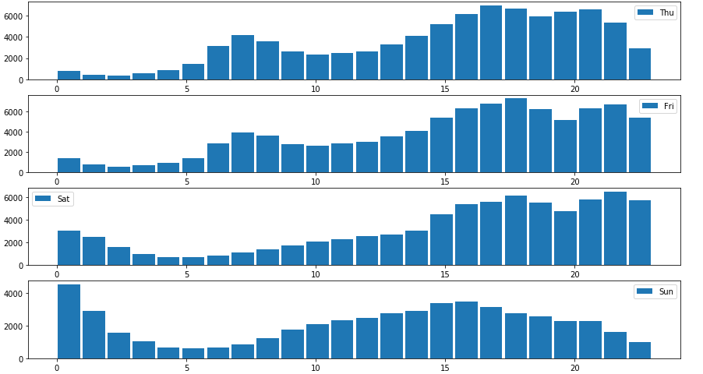
Visualize data and find insights

Slide 21
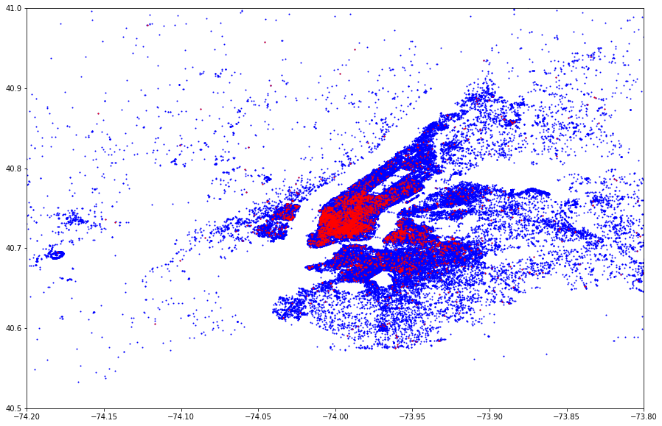
Visualize data and find insights

Slide 22
Thank you, and I hope you’ve enjoyed this intro!
Where do we go from here?
Seaborn: More powerful charts.
Explore and play with free data sets from Kaggle.com
Machine learning

